Slide 1
Economic Inequality: Are We Measuring It Right and What Does It Mean?
Cato Institute, Capitol Hill Forum
April 29, 2019
John F. Early
President, Vital Few, LLC

Slide 2
Our Inquiry Today
Evaluate the data:
  Income inequality
  Poverty
Assess both levels and trends.
What official data miss.
More complete measures.

Slide 3
Census Money Income
Headline data for inequality and poverty
Earned income
  Employment earnings
  Interest, dividends, rents, royalties, trusts
  Private and employer-paid retirement, survivor, and disability
Private transfers
  Child support, alimony, education, other
Social insurance transfers
  Social Security (OASDI)
  Unemployment & workers’ compensation
Other government transfers
  Public assistance: TANF and state programs
  Supplementary Security Income (SSI)
  Education assistance

Slide 4
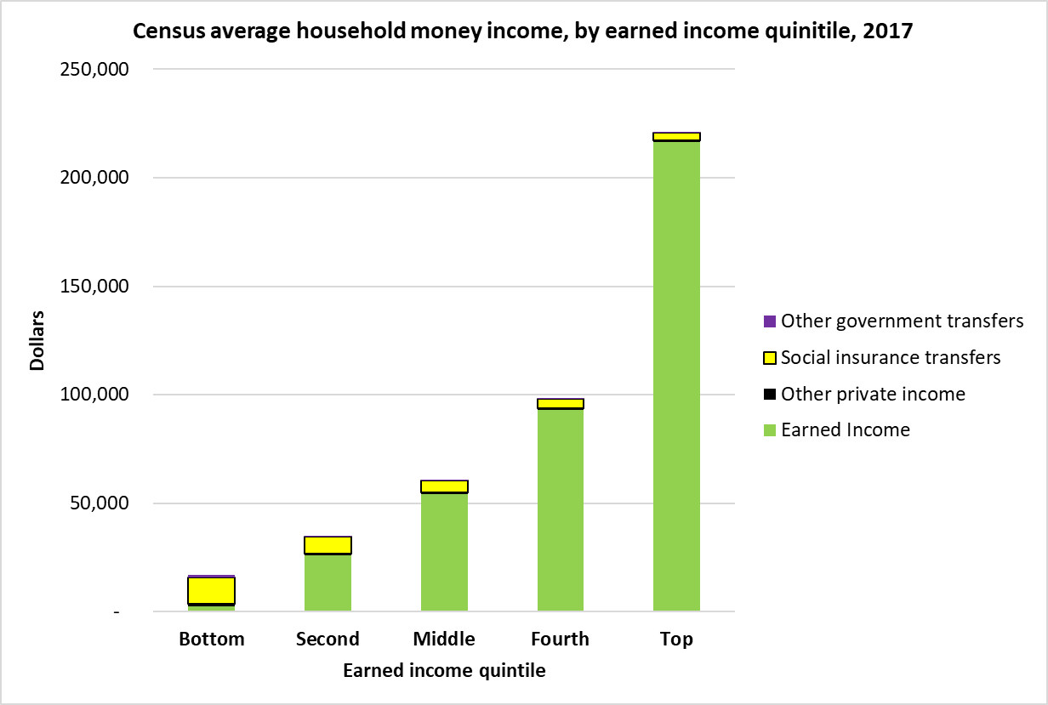
Census Money Income
Composition, Difference Ratios, Percent Additions to Earned
Income from non-earned sources as percentage of earned income.
Total Income Ratio Top to Bottom = 13
+2%
+5%
+12%
+36%
+615%

Slide 5
Census Money Income: What’s Missing
Excluded $1,506 billion in transfers:
  Medicare, Medicaid, and SNAP are largest.
  Refunded tax credits.
  Other nutrition, rent subsidies, home energy.
  $308 billion more.
Under-reporting of included-transfers, $139 billion.
Employer-paid taxes, health insurance, etc.
High end: capital gains and unreported
Low end: second/sporadic employment, unreported
60% of earned retirement income
Taxes

Slide 6
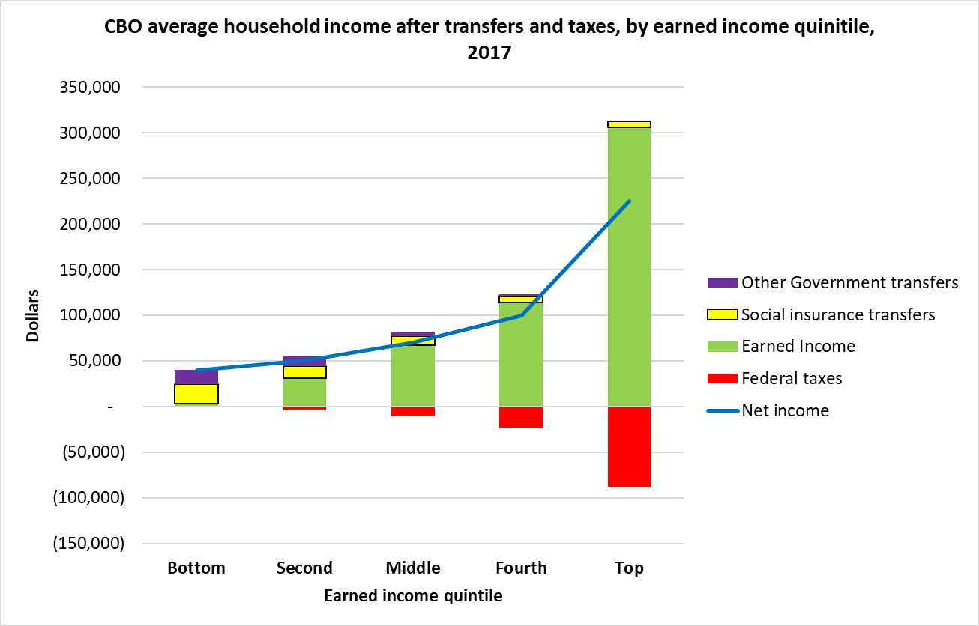
CBO Income After Transfers and Taxes
Composition, Difference Ratios, Percent Additions to Earned
Net Income Ratio Top to Bottom = 6
-26%
+62%
-12%
+1126%
+5%

Slide 7
CBO Estimates: What’s Still Missing
State and local taxes, 4% of federal taxes.
$308 billion transfers omitted:
  71 identified federal programs.
  State programs other than cash public assistance.
  Student loan subsidies.
  Most public housing.
  “Unattributable” transfers.
“Extreme” poverty cases – 64% aren’t poor.

Slide 8
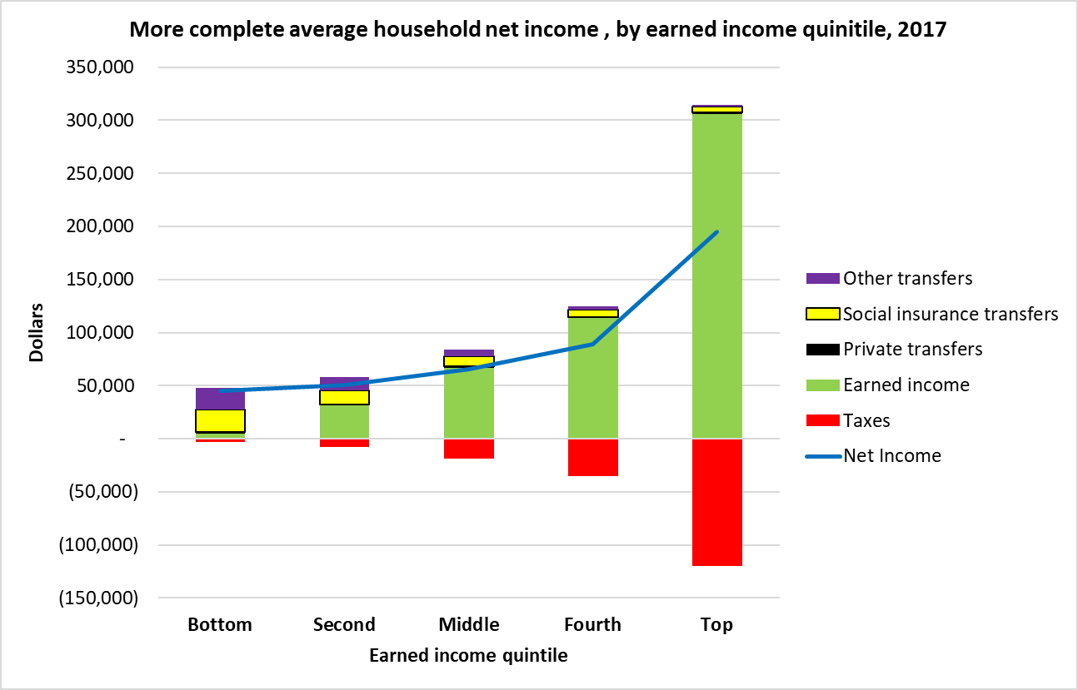
More Complete Income Distribution
Composition, Difference Ratios, Percent Additions to Earned
Net Income Ratio Top to Bottom = 4
-36%
+802%
+62%
-22%
-3%

Slide 9
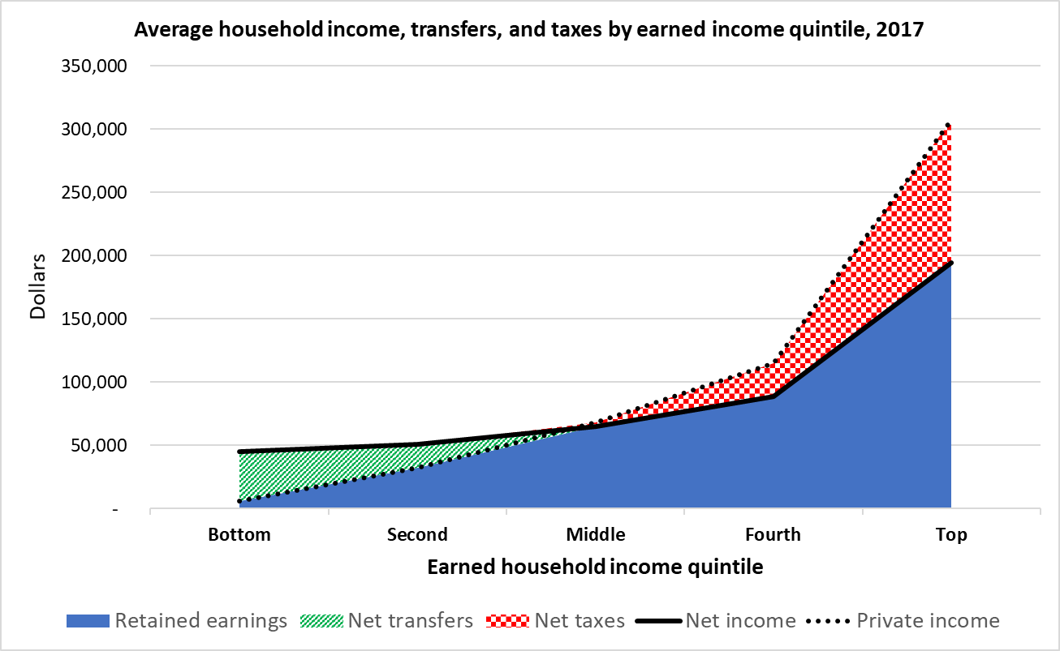
Net Transfers, Taxes, Income

Slide 10

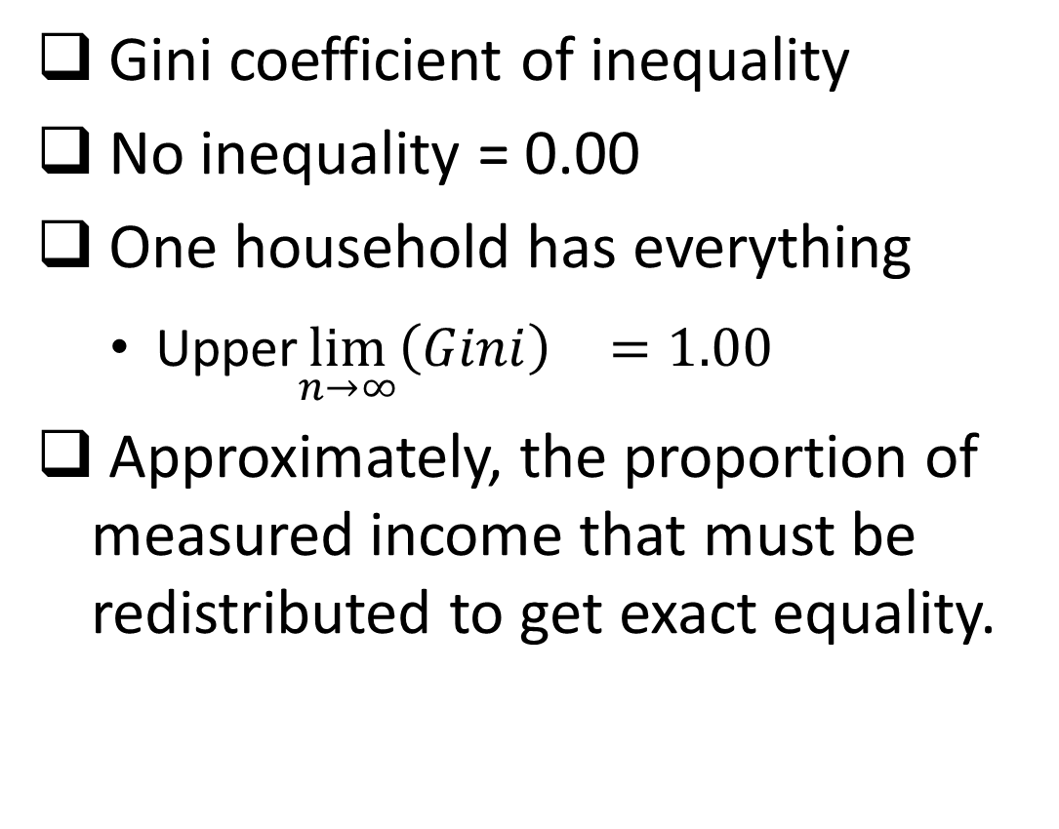
The Gini is Out of the Bottle
Gini coefficient of inequality
No inequality = 0.00
One household has everything
  Upper$\lim_{n→∞}{{\left(Gini\right)}^{}}=1.00$
Approximately, the proportion of measured income that must be redistributed to get exact equality.

Slide 11
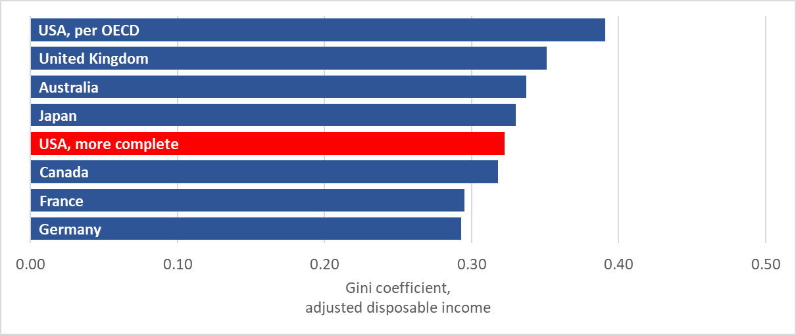
OECD Publication of Gini’s, ca. 2015

Slide 12
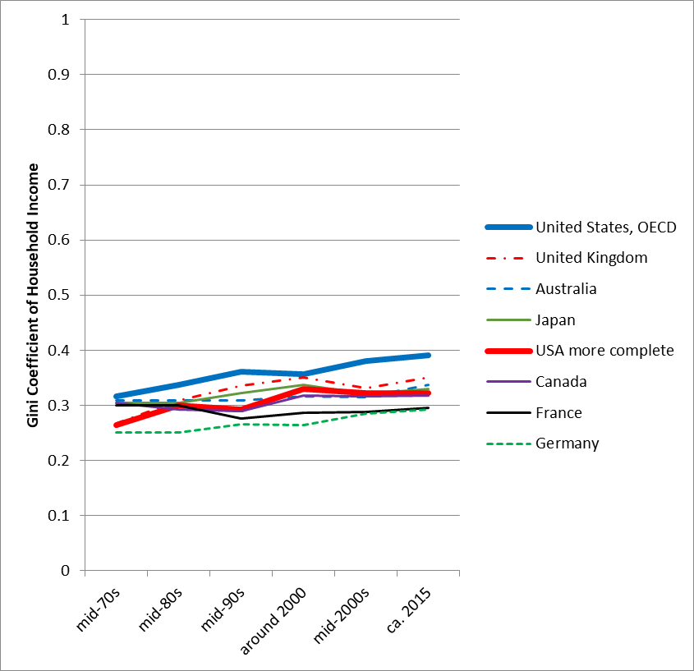
Gini Trends Major Advanced Countries

Slide 13
Poverty Incidence
Thresholds
  Cost of 1963 “economy” diet, times 3.
    Agriculture/BLS family budget food plans.
    “3X” from average family in 1958 survey.
  Adjusted for inflation by CPI-U
Census money income
  All the limitations already discussed.

Slide 14
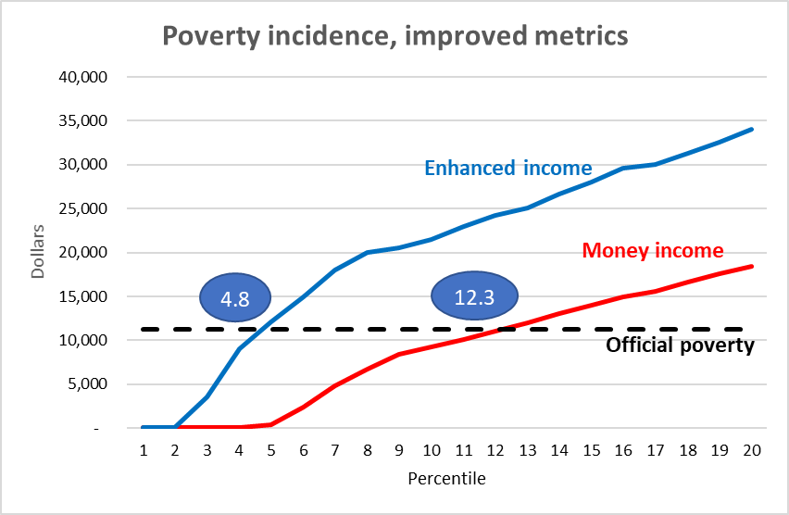
More Complete Income Effect on Poverty

Slide 15
Poverty Incidence
Thresholds
  Cost of 1963 “economy” diet times 3
    Agriculture/BLS family budget food plans
    “3X” from average family in 1958 survey
Adjusted by CPI-U
  Substitution bias
  New product and quality bias
  Outlet bias
Official increase 1963-2017: 701%
  Only 365% was true price increase
  72% higher standard of living

Slide 16
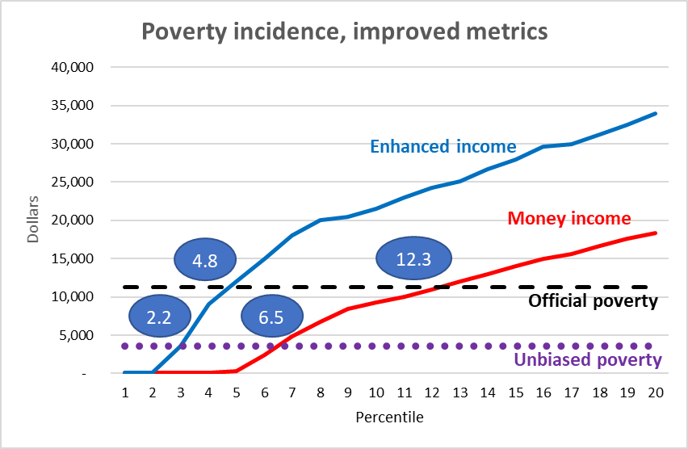
Effects of Enhanced Income & Escalation

Slide 17
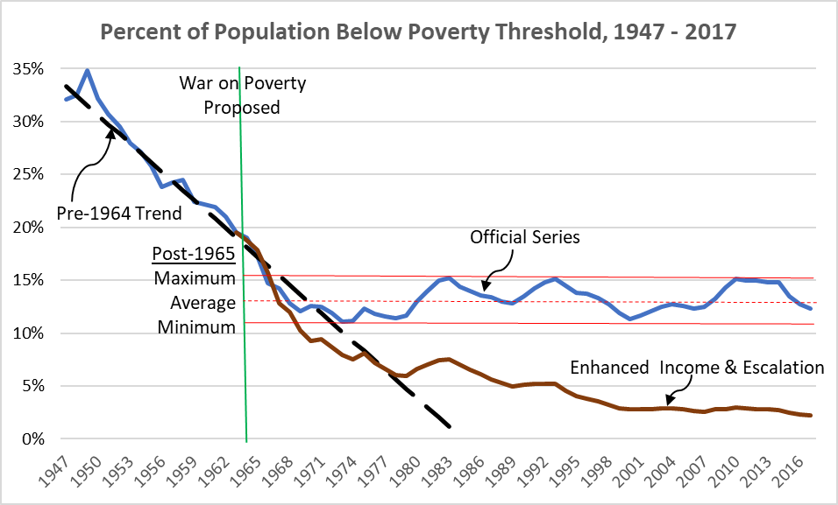
Poverty Incidence, Escalation & Income Effects

Slide 18
Summary
Transfer payments and taxes eliminate 93% of earned income inequality.
Income inequality in U.S. is not greater than in other advanced countries.
Official data on income inequality overstate it by a factor of three.
Official measures of poverty incidence are overstated by a factor of five.
These are not accidental mistakes, but definitional failures to use all the information.

