Slide 1
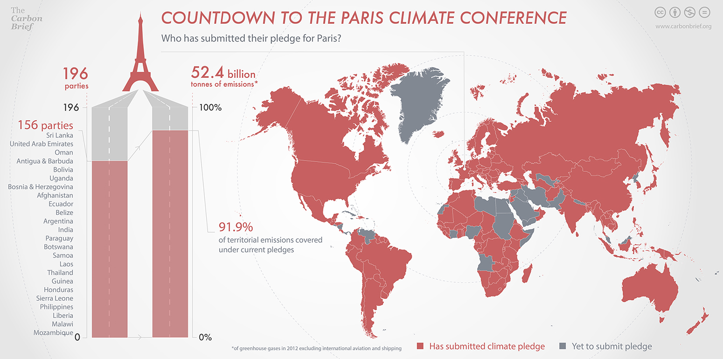
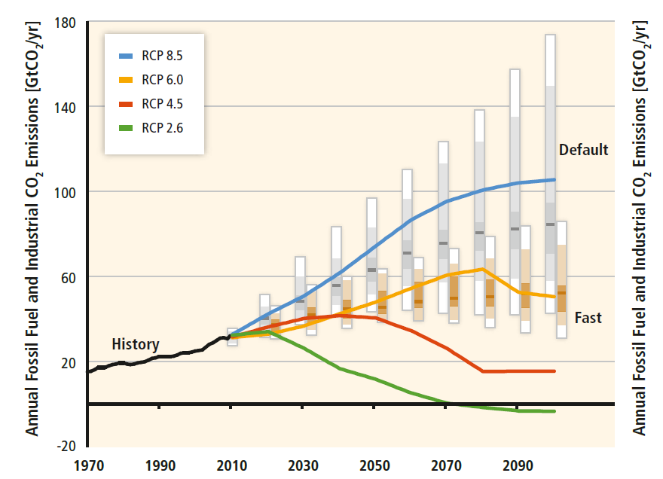
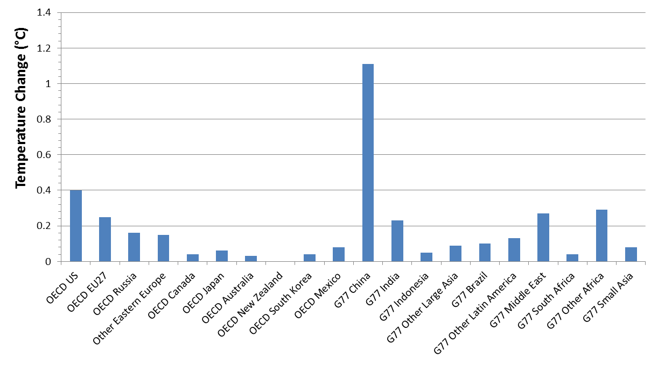
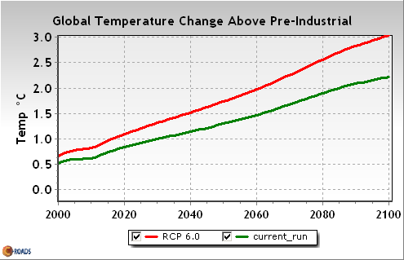
Climate Expectations from Paris
Paul C. Knappenberger Center for the Study of Science
Cato Institute
Preparing for Paris: What to Expect from the U.N.’s 2015 Climate Change Conference October 30, 2015

Slide 2
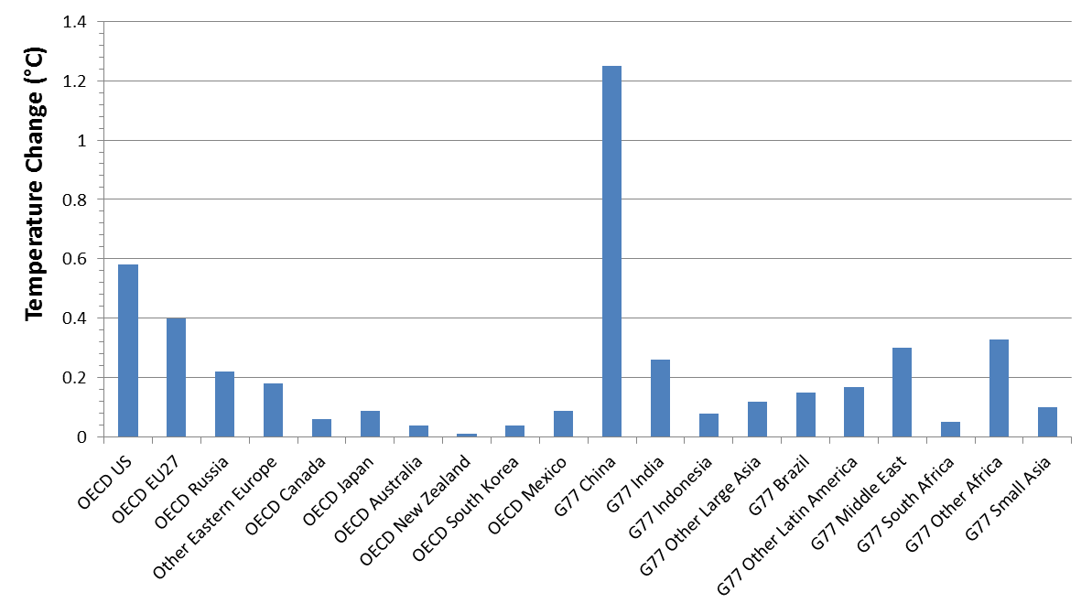
Projected Temperature Contribution
RCP8.5, 1850-2100
Total Warming=4.5ºC
Source: C-ROADS

Slide 3
Projected Temperature Contribution
RCP8.5, 2015-2100
Total Warming=3.6ºC
Source: C-ROADS

Slide 4
The Issue
What is the climate impact of the Intended Nationally Determined Contributions (INDCs)?
The goal of the U.N. negotiations are to limit the rise in the global average surface temperature to 2.0ºC above the pre-industrial temperature.
How are we doing?

Slide 5
INDCs
INDCs have been submitted from 156 countries covering 91.9% of emissions (as of October 23, 2015)

Slide 6
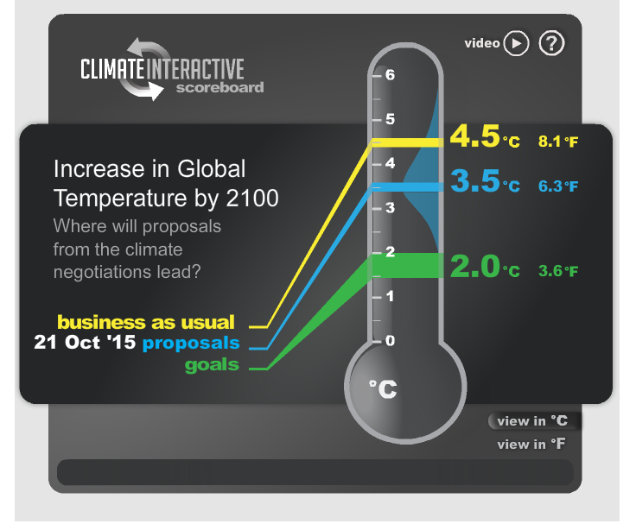
Climate Impact
Climate Interactive
Climate Action Tracker
4.5ºC
“baseline”
climateinteractive.org
climateactiontracker.org

Slide 7
Progress?
The “current pledges” make it seem like an impact on future temperature change is being achieved (e.g., 3.5ºC vs. 4.5ºC).
“Business-as-usual” (Climate Interactive) and “baseline” (Climate Action Tracker) scenarios are actually worst case scenarios.
Each is based upon the IPCC RCP8.5 pathway.
The IPCC AR5 WGIII describes the RCP8.5 pathway as:
“The RCP 8.5 pathway has higher emissions than all but a few published baseline scenarios.”
“Baseline scenarios are projections of GHG emissions and their key drivers as they might evolve in a future in which no explicit actions are taken to reduce GHG emissions.”

Slide 8
Business-as-Usual
Business-as-Usual (baseline) is not a frozen technologies scenario.
Business-as-usual is dynamic and improving.
Source: Adapted from IPCC AR5 WGIII

Slide 9
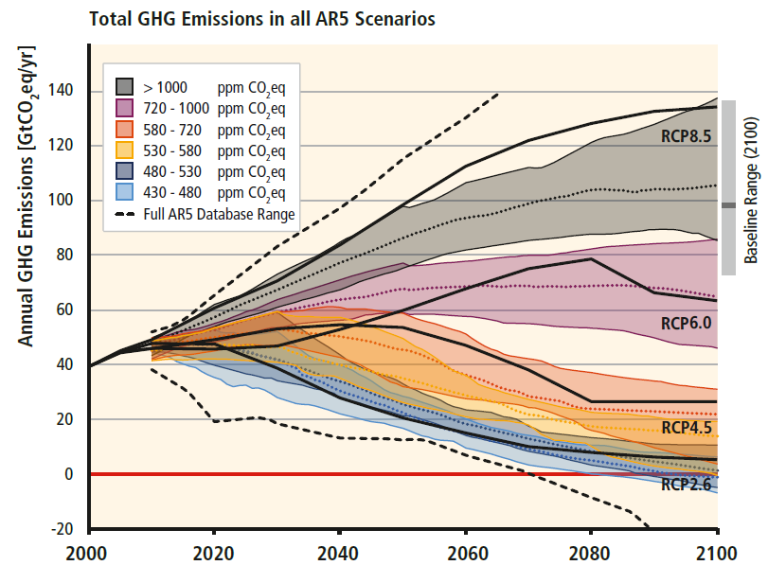
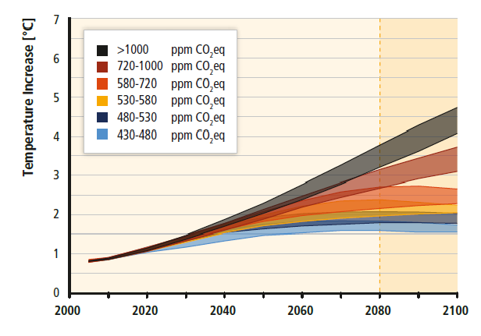
Business-as-Usual
Projected Temperature Rise: ~3.5ºC
Baseline
Equilibrium Climate Sensitivity = 3.0ºC
Source: Adapted from IPCC AR5 WGIII

Slide 10
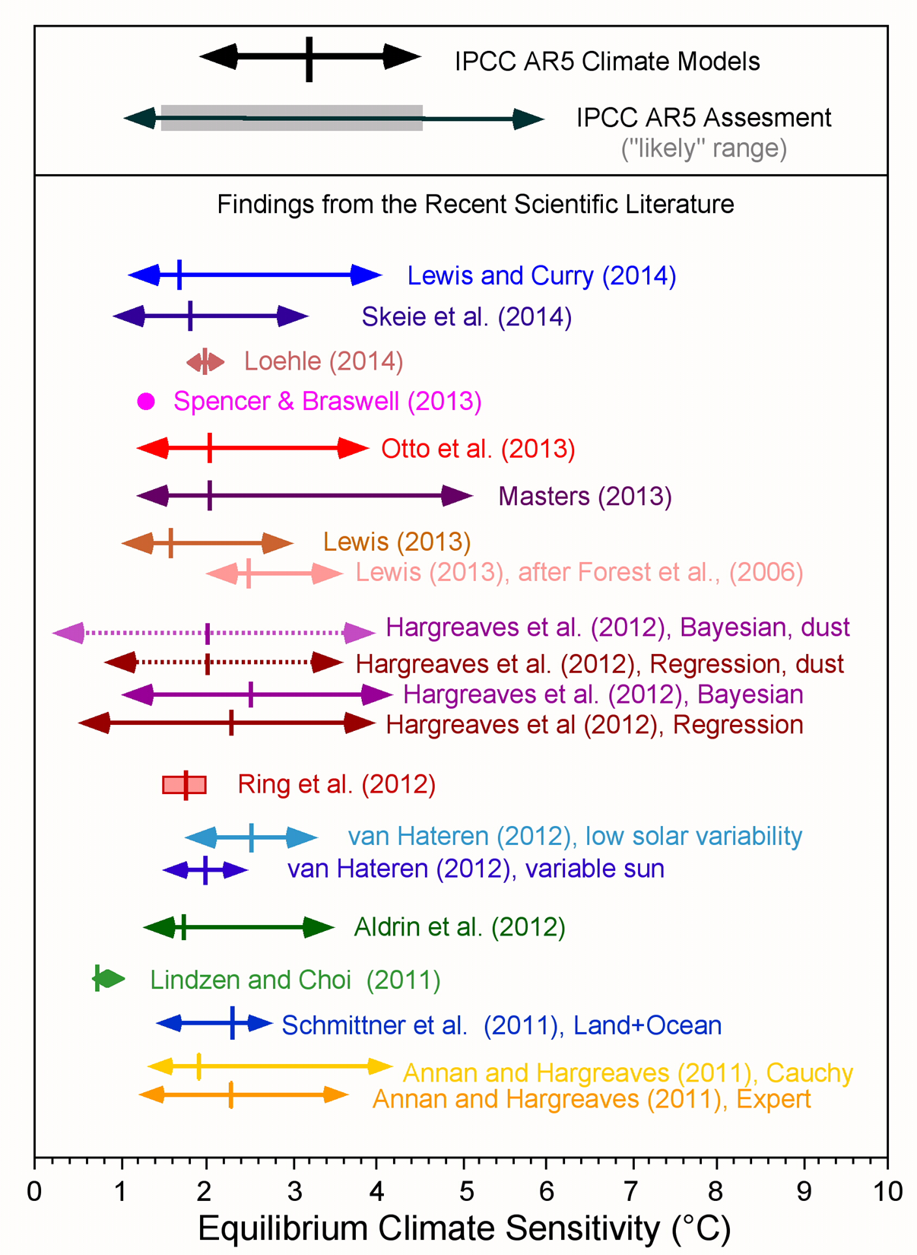
Equilibrium Climate Sensitivity
IPCC AR5 “assessment”:
“ECS is likely in the range 1.5ºC to 4.5ºC (high confidence), extremely unlikely less than 1ºC (high confidence), and very unlikely greater than 6ºC (medium confidence).”
Average equilibrium climate sensitivity (ECS) of climate models used by IPCC AR5 is 3.2ºC.
Large collection (at least 14 studies published since 2011) of scientific studies suggest a lower and more constrained estimate of the ECS.
Central estimate of new science about 2.0ºC.
Source: Michaels and Knappenberger, 2014

Slide 11
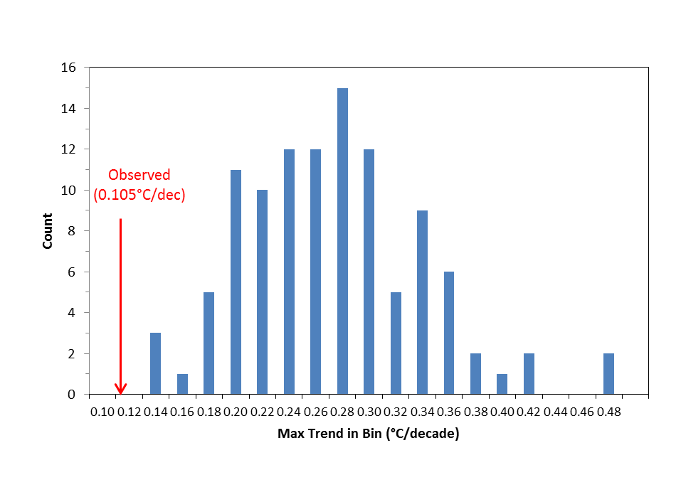
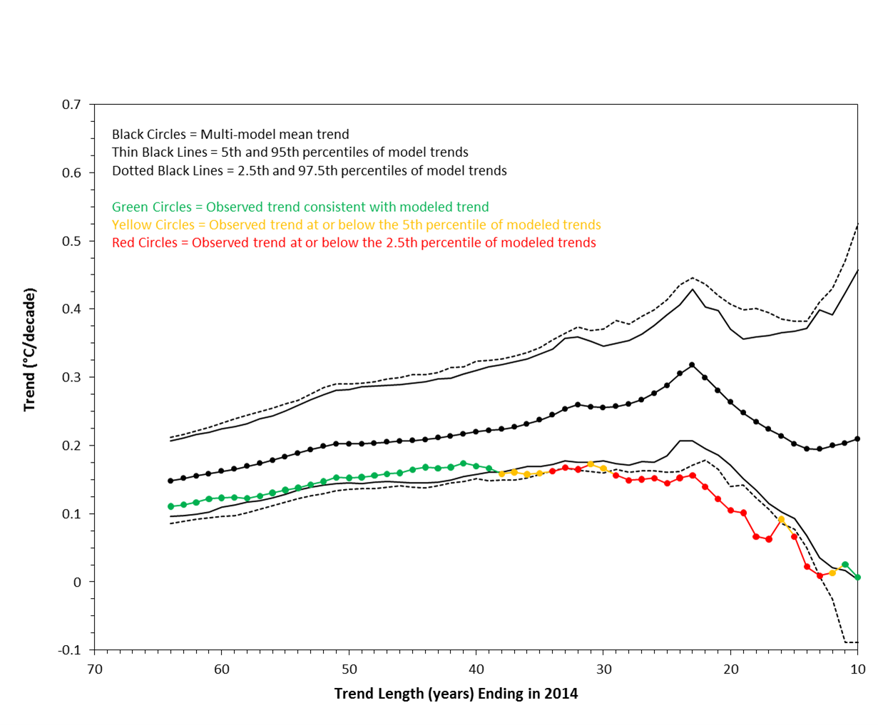
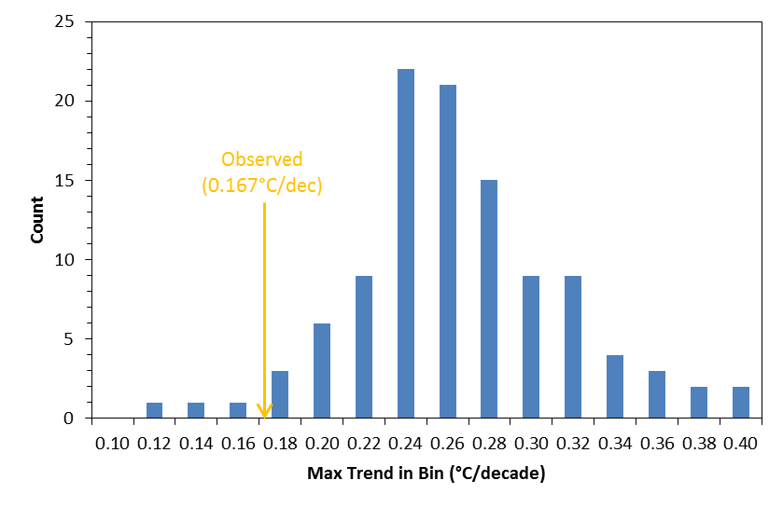
Models vs. Observations
20-yr Trend (1995-2014) Distribution
Projected and Observed Trends
30-yr Trend (1985-2014) Distribution
Climate models are running hot.
Source: Michaels and Knappenberger, 2014

Slide 12
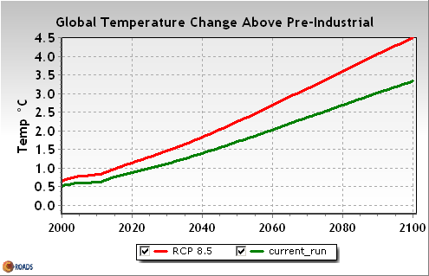
Projections (revisited)
Collection of evidence suggests equilibrium climate sensitivity of ~2.0ºC.
Current modelling exercises run using climate sensitivity of ~3.0ºC (some 50% higher).
Running models with 2.0ºC instead of 3.0ºC gives BAU warming by 2100 of ~2.5ºC (or even lower considering natural gas revolution).
2.0ºC “target” is still in play…even if we don’t take directed actions.
“The U.N. should cancel its Paris meeting.” –P.J. Michaels

Slide 13
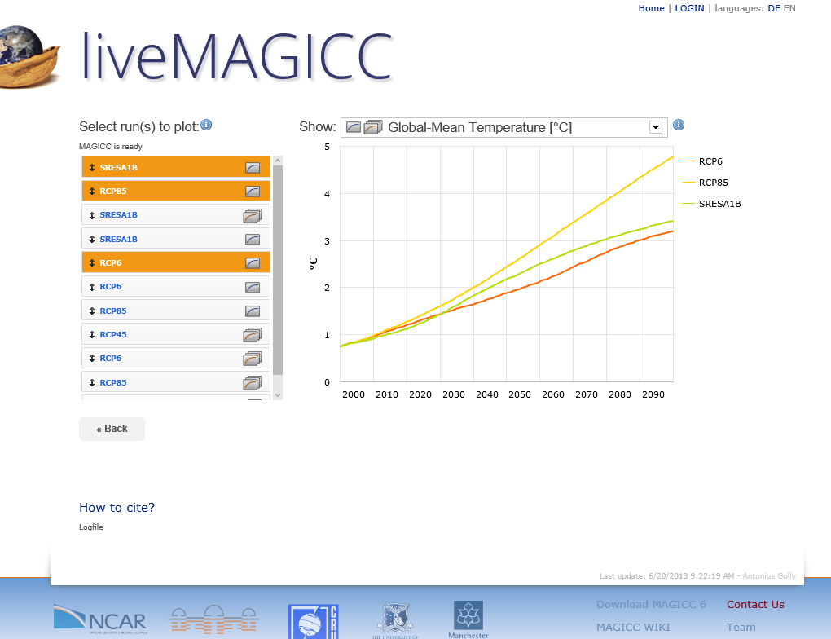
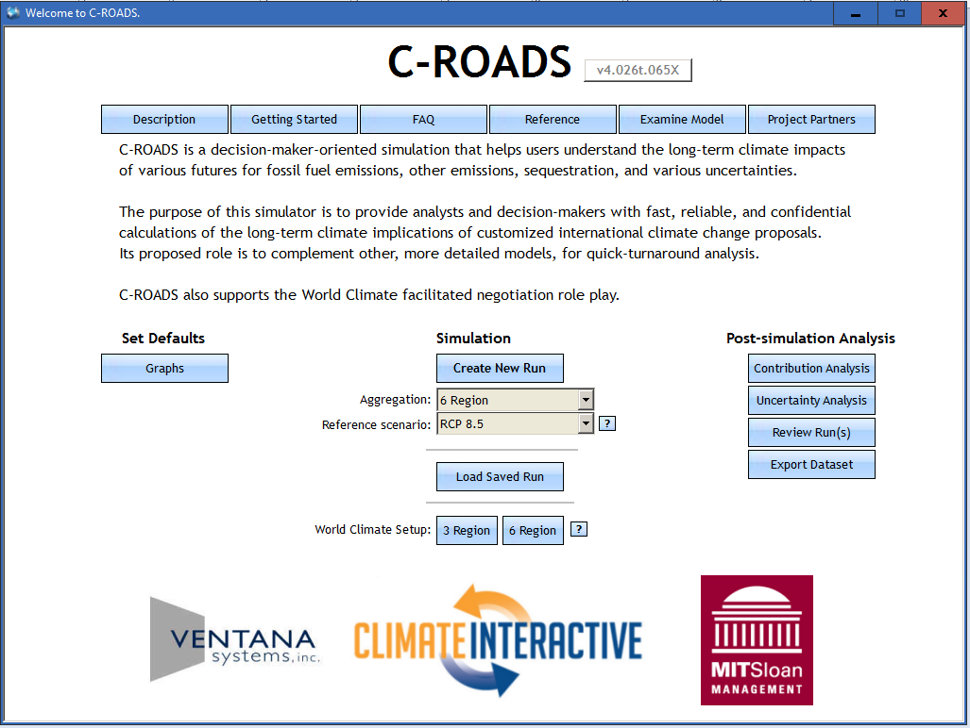
See For Yourself
On-line Modeling Tools
live.magicc.org
www.climateinteractive.org/tools/c-roads/

Slide 15
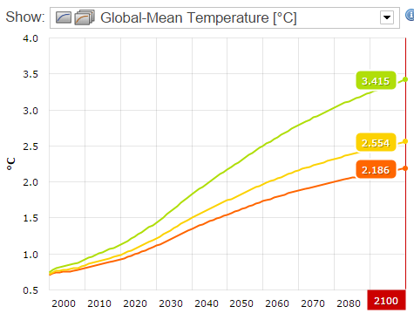
Temperature Projections
SRES A1B
ECS=3.0ºC
ECS=2.0ºC
ECS=1.6ºC

Slide 16
Scenarios

