Slide 1
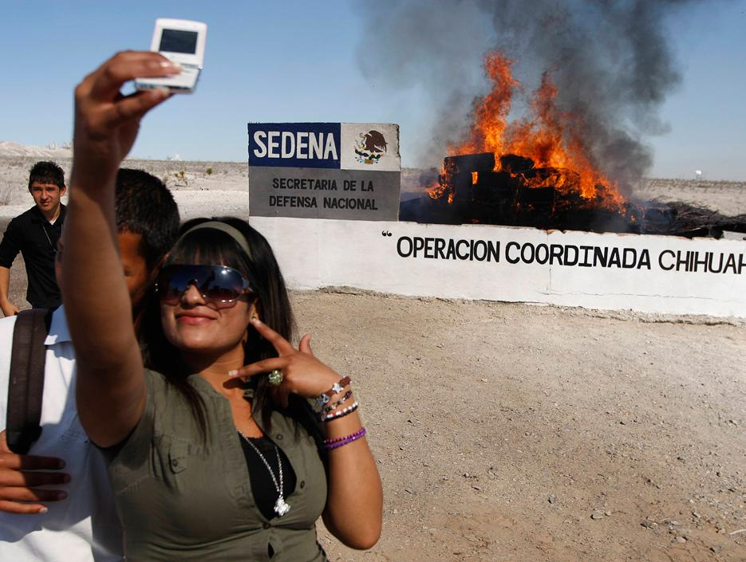
Telling Stories with New Media, Technology, and Big Data
Andrés Monroy-Hernández
Microsoft Research, FUSE Labs
Harvard Berkman Center
@andresmh
Cato Institute,
Washington, DC, March, 12 2013
© Gael Gonzalez/Reuters

Slide 2
Outline
Mexican Drug War
Information War
Tweeting the War
Citizen News Curators
Conclusions

Slide 3
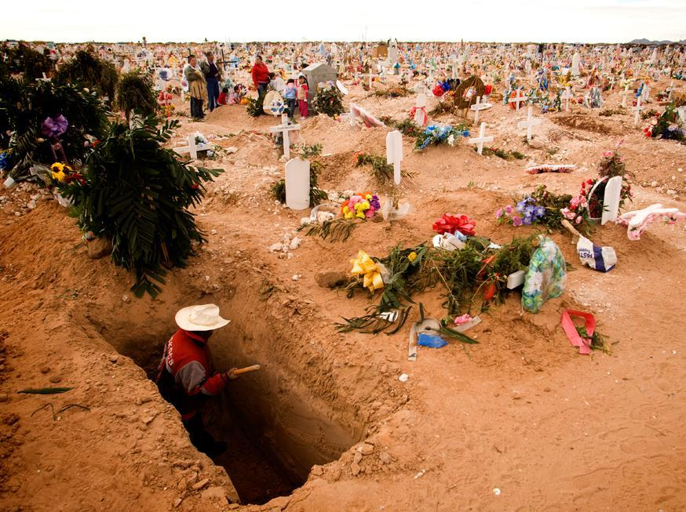
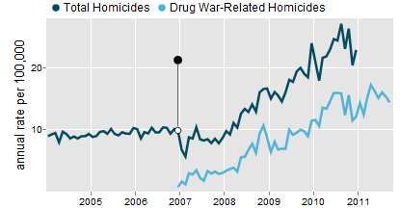
Mexican Drug War
~60,000 deaths¹
~230,000 displaced²
³
Calderón Administration
3
¹ Semanario Zeta, Dec 12, 2011,
² Internal Displacement Monitoring Centre, 2011,
³ Diego Valle with Official Numbers from PGR, SINAIS, INEGO.
©Nadav Neuhaus
Notes:
Numbers are contested. Some context. Mexican Drug War. Started by President Calderon in 2006. [add image source]

Slide 4
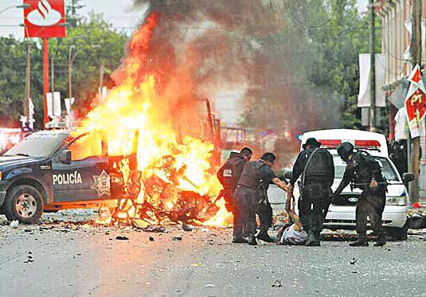
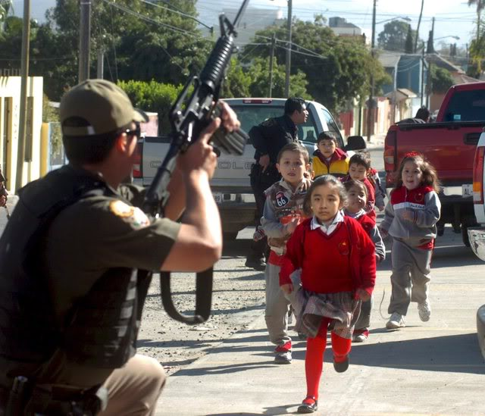
Crises part of everyday life
El Mañana
Notes:
Shootings, grenade attacks and even car bombs.
In some Mexican cities violence, crises are part of everyday life

Slide 5
Outline
Mexican Drug War
Information War
Tweeting the War
Citizen News Curators
Conclusions

Slide 6
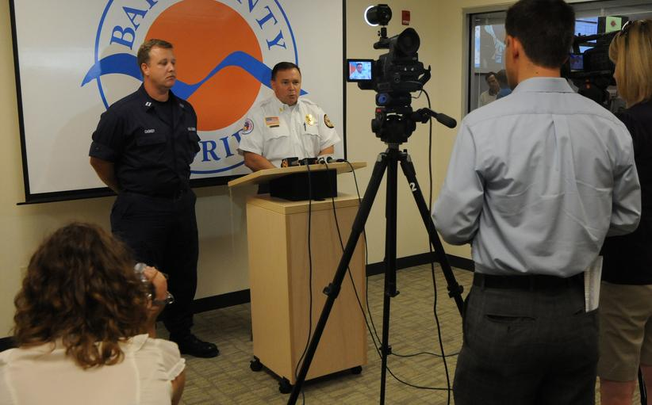


Typical Emergency Response
EPI2oh on Flickr
Notes:
Quite a bit of work on the field of Crisis Informatics. Typically when crises emerge, governments and the media are there to inform us. In the US the government has developed the role of Public Information Officers (PIOs) which has been documented by Palen and others.

Slide 7
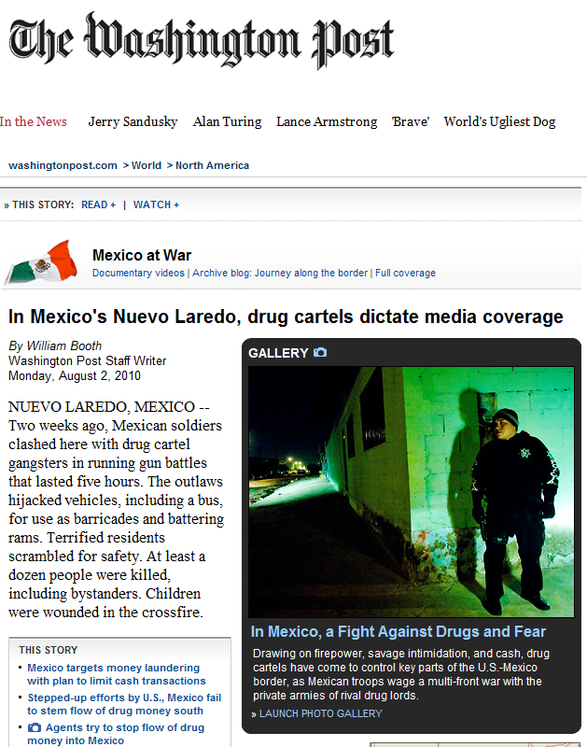
“Fearing for their lives and the safety of their families, journalists are adhering to a near-complete news blackout, under strict orders of drug smuggling organizations and their enforcers, who dictate via daily telephone calls, emails and news releases what can and cannot be printed or aired.”
Notes:
MSM

Slide 8
“The news blackout extends to government officials. In Nuevo Laredo, the mayor mysteriously disappears for days and refuses to discuss drug violence. The military general who presides over the soldiers patrolling the city does not hold news conferences, issue statements or answer questions from the media.”
Notes:
Caveat #1: hard to find ground truth.

Slide 9
Outline
Mexican Drug War
Information War
Tweeting the War
Citizen News Curators
Conclusions

Slide 10
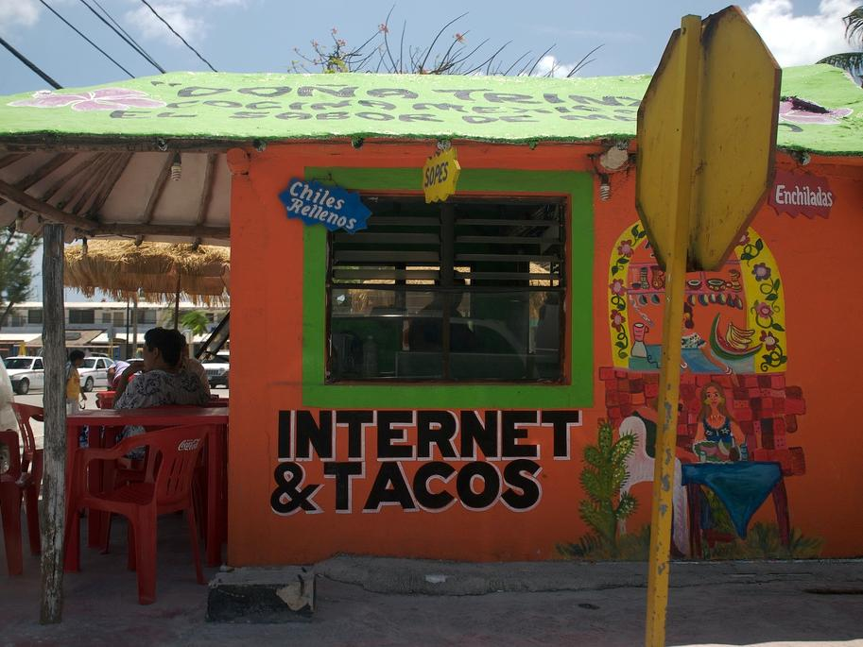
Internet Users¹
17% (yr. 2000) → 34% (yr. 2010)
34 million users
Social Media¹
61% of Internet users
Twitter²
20% of SM users
5th largest country
¹ Asociación Mexicana de Internet, 2011
² Oxford Internet Institute, 2012
(cc) Lecates on Flickr
Notes:
“The six largest countries in terms of information production through Twitter” OII

Slide 11
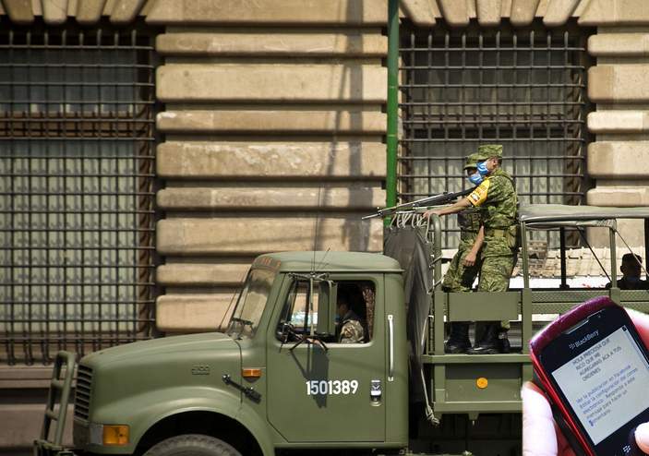
Weakened Institutions
Increased
Violence
Social Media
Adoption
Based on photo by Eneas on Flickr

Slide 12
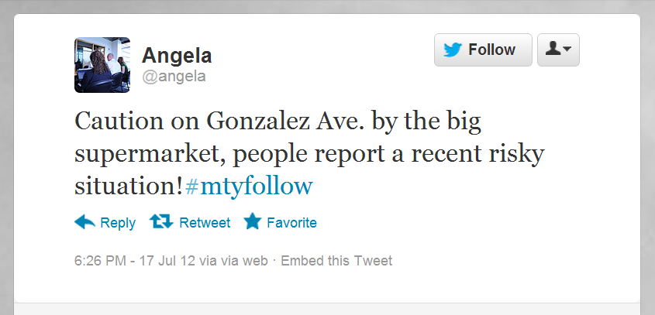
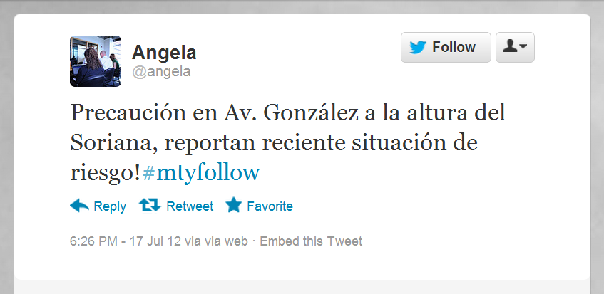
Notes:
example

Slide 13










Information Ecosystem
Notes:
Caveat #2: Twitter is part of an information ecosystem. What we observe there is part of the story.

Slide 14
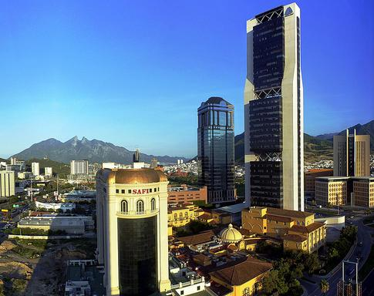
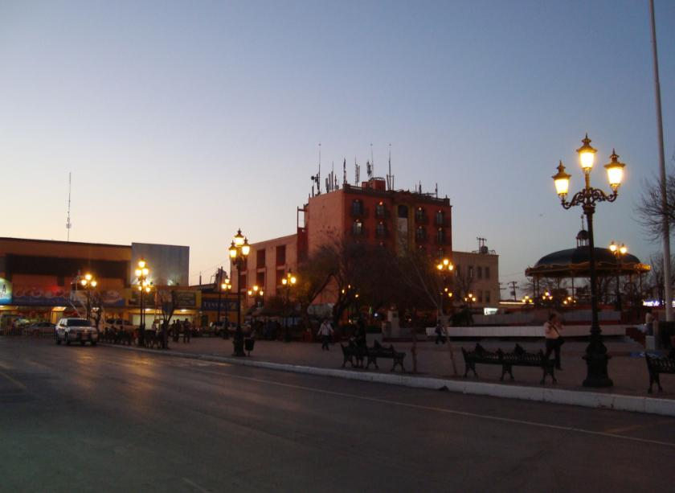
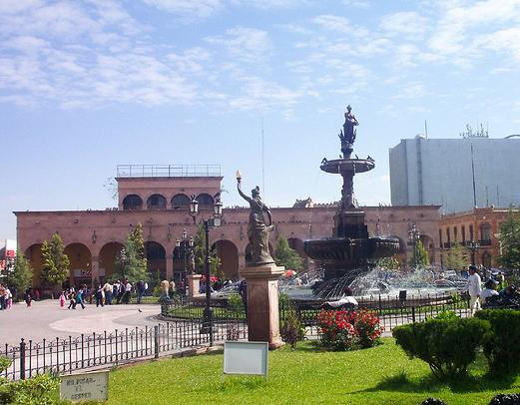
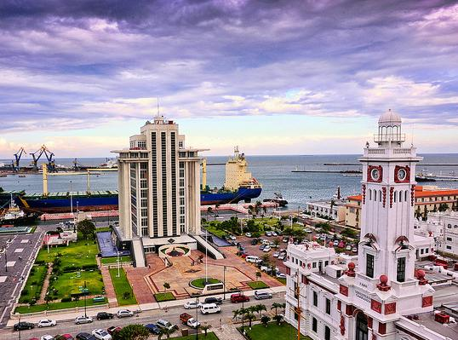
Monterrey
Population: 4,000,000
Reynosa
Population: 600,000
AmateurArtGuy on Flickr
d∂wn on Flickr
Saltillo
Population: 800,000
Veracruz
Population: 700,000
Sachavi on Flickr
Eduardo Pavon on Flickr
Notes:
Picked because of the high level of violence, use of Twitter, and personal familiarity.
City of Boston: 617,594
Greater Boston area: 4,522,858

Slide 15
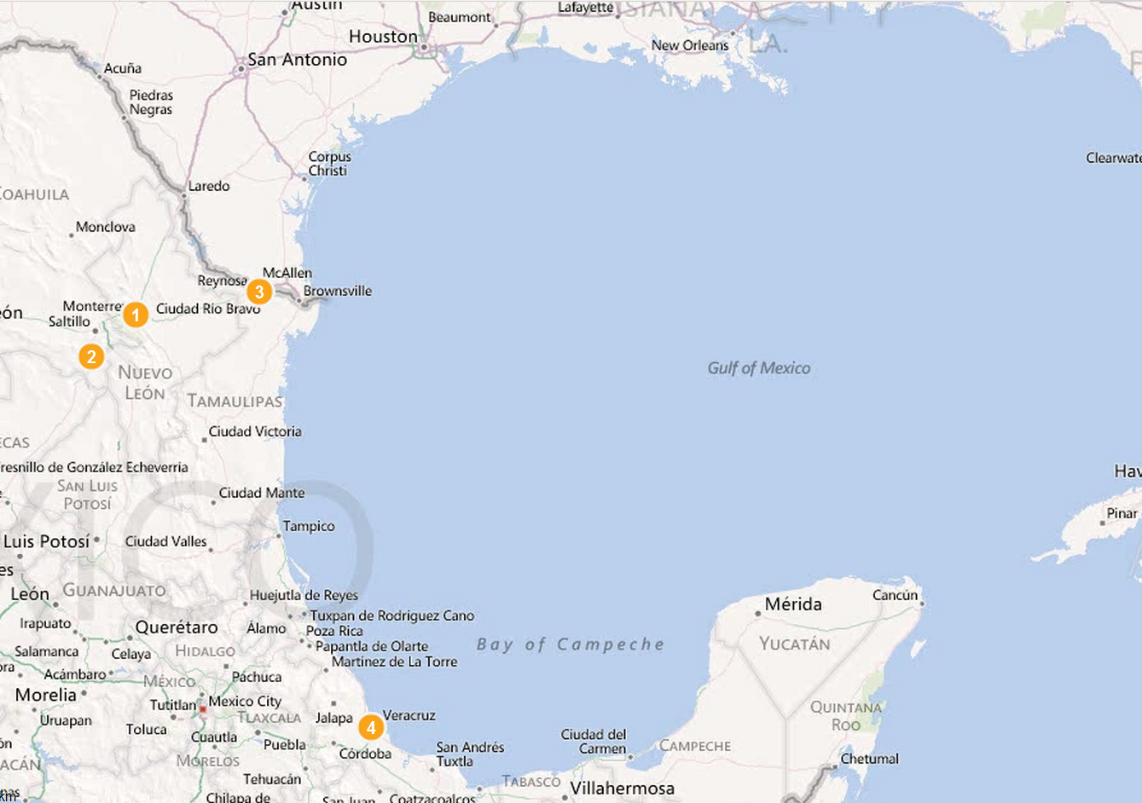
How many tweets?
Aug 2010 → Nov 2011
609,744 tweets
City | Hashtag | Tweets | Users
1. Monterrey | #mtyfollow | 211,278 | 27,170
2. Reynosa | #reynosafolllow | 155,786 | 9,043
3. Saltillo | #saltillo | 153,879 | 16,347
4. Veracruz | #verfollow | 87,801 | 12,522
Notes:
16 months

Slide 16
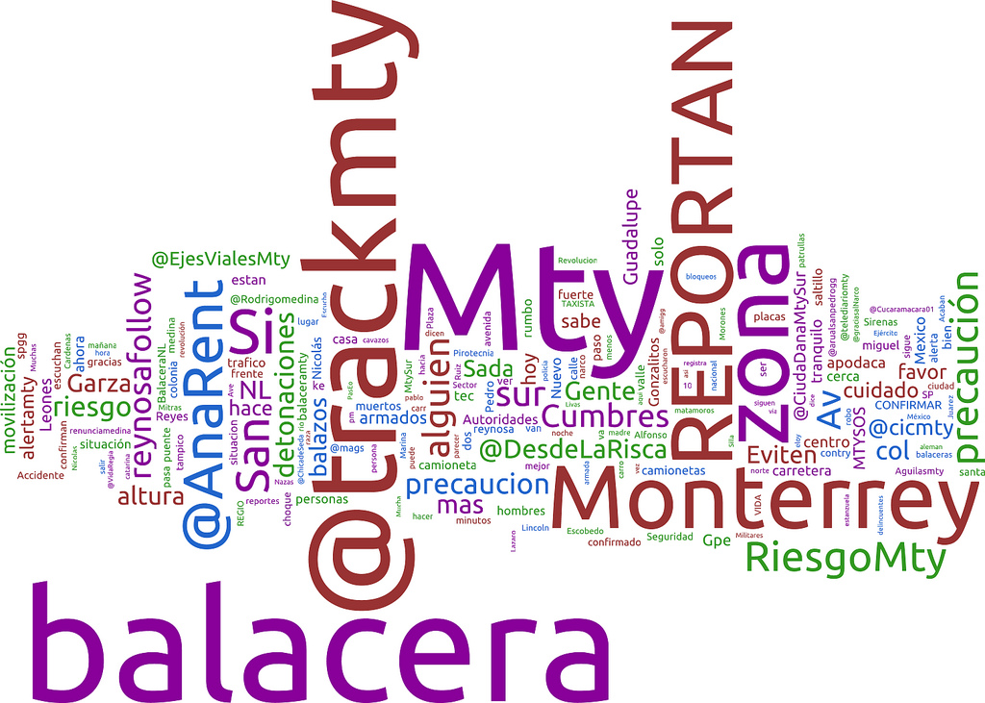
What are people tweeting about?
Notes:
Balacera = shooting , detonaciones = blasts, Garza = Street name, Eviten = avoid

Slide 17
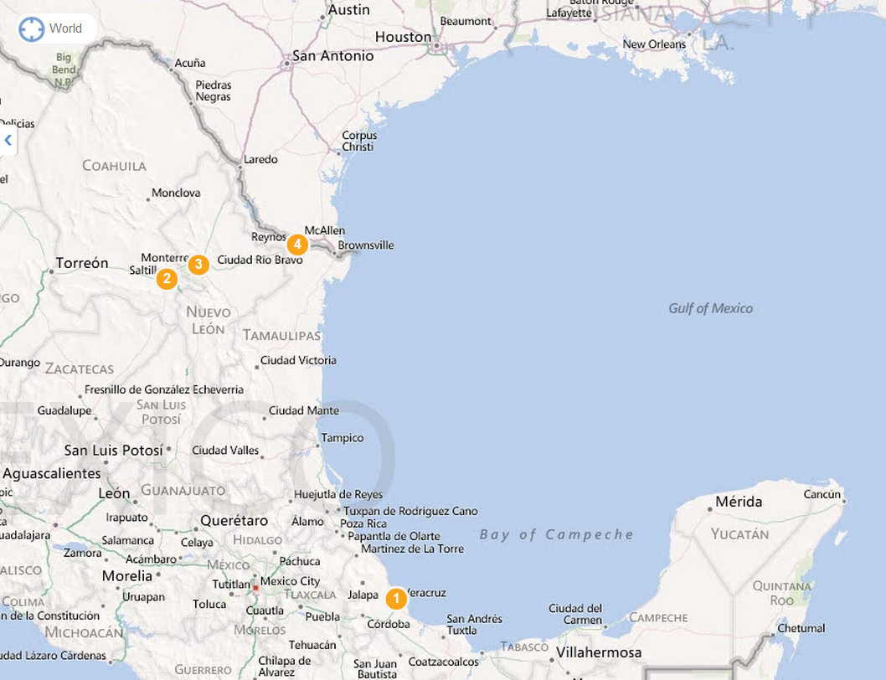
What are people tweeting about?
Frequency | Types of Words | Spanish
1 | places | zona, san, sur, altura, garza, col., av.
2 | shootings | #balacera, balacera, balazos, detonaciones
3 | report | reportan
4 | people | gente, alguien

Slide 18
What kind of tweets?
City | Mentions | Retweets
#mtyfollow | 20.5% | 40.1%
#reynosafollow | 24.8% | 15.9%
#saltillo | 19.9% | 29.9%
#verfollow | 22.5% | 35.3%
Disseminating > Interacting
Notes:
Interaction > Dissemination 16 months – Seattle with mentions (50.7%) were more common than retweets (15.7%).

Slide 19
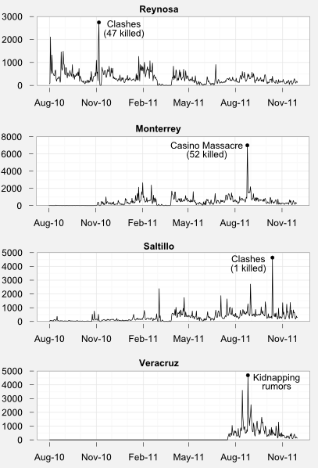
How often?
#reynosafollow
Daily median: 249
#mtyfollow
Daily median: 340
spread
#saltillo
Daily median: 219
#verfollow
Daily median: 494
Notes:
The number of daily tweets per day goes up and down constantly, spiking when violence erupts then decreasing when the city is calm. Staggered adoption. Practices are passed from city to city.

Slide 20
Outline
Mexican Drug War
Information War
Tweeting the War
Citizen News Curators
Conclusions

Slide 21
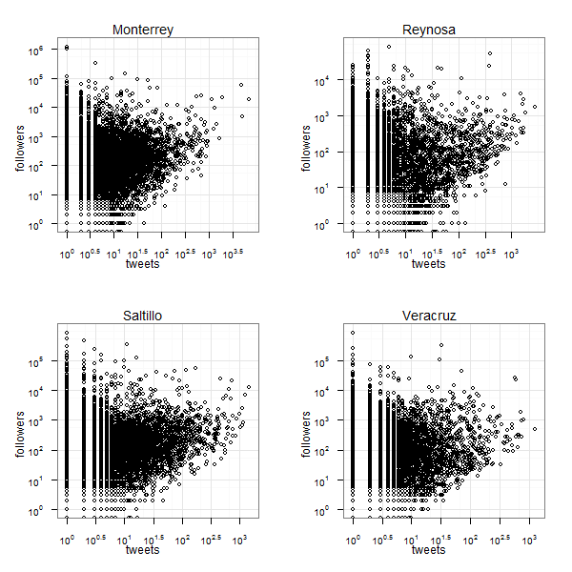
#mtyfollow
#reynosafollow
Who is tweeting?
#saltillo
#verfollow
Notes:
Who?

Slide 22


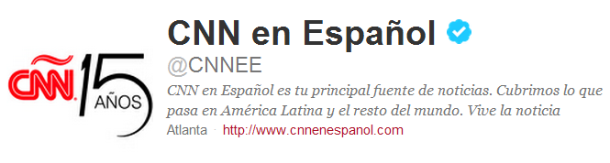
Curators
Average citizens
Notes:
Followers: Captured at the moment of the last tweet.
Curators: Act as operators. Mostly (selfrepoted) females.

Slide 23
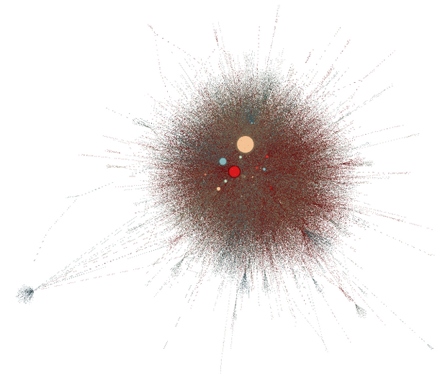
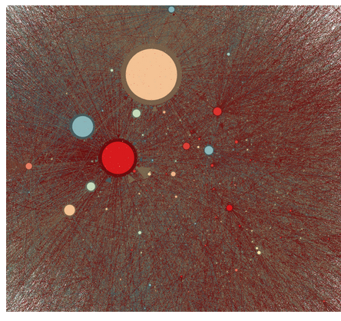
Retweet network
curators
Size: in-degree (PageRank)
Notes:
Outsiders: celebrities.
Size: in-degree, denotes who id being RTed. Meaning: I trust the information that is given
Biggest node: a curator. Third most followed account in #ABCity, behind Calderon, TVNews.
Top 13 are anonymous, retweet each other too.

Slide 24
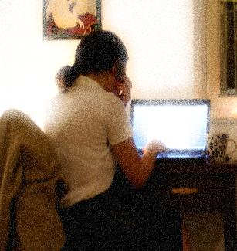
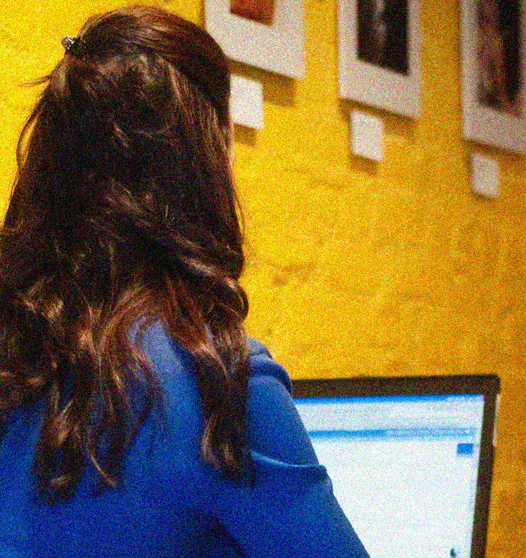
Interviews
“Angela”
“Claudia”
Followers: 25K
Tweets: 35K
Hours/day: 15
Age: early 20’s
Followers: 30K
Tweets: 60K
Hours/day: “many”
Age: ?
Photo: mr. toaster on Flickr
Photo:CarbonNYC on Flickr
(in Spanish)
Notes:
Fictitious names, photos. Contacted several of them. 4 replied. I present here some of the highlights of my conversation with 2.

Slide 25
How did you get started with Twitter?
“Angela”
“Claudia”
“It was through a friend. She said: ‘you have to go to Twitter! it’s so cool!’” (Joined in late 2009)
“…by chance. I heard on the radio about how celebrities would interact with their fans.” (Joined in mid 2009)
Photo: mr. toaster on Flickr
Photo:CarbonNYC on Flickr

Slide 26
How would you describe your role?
“Angela”
“Claudia”
“I’m a journalist … It is as if I was a war correspondent, on social networks, of the war we are living in Mexico.”
“My role on Twitter is that of yet another citizen. [People] tell me that I’m like their ‘angel,’ for looking after them”
Photo: mr. toaster on Flickr
Photo:CarbonNYC on Flickr

Slide 27
Motivations
“Angela”
“Claudia”
“I consider this as a community service, even though people might laugh about it.”
“…tweeting is an altruistic community service.”
Photo: mr. toaster on Flickr
Photo:CarbonNYC on Flickr

Slide 28
What are your sources ?
“Angela”
“Claudia”
“Not all the information comes from Twitter. There’s a lot of people who know what I do. They have my number and they call me… they are 100% citizens.”
“Most of the information is from los tuiteros, my followers. In other cases, it’s the reporters on TV, local news...”
Photo: mr. toaster on Flickr
Photo:CarbonNYC on Flickr
Notes:
Angela: Triangulation. Contacts Distributed geographically.
Trust: “I can’t recommend anyone after what happened with [name of curator]. I can’t vouch for anybody, because I don’t know who is behind that account.”
Claudia: “Not all my followers send me information but I am very thankful to those who take the time to do it

Slide 29
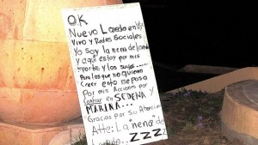
Notes:
La nena de Laredo
$600,000 pesos

Slide 30
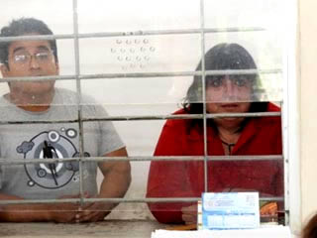
Notes:
Government. Engages or attacks.

Slide 31
Outline
Mexican Drug War
Information War
Tweeting the War
Citizen News Curators
Conclusions

Slide 32
Conclusions
  Social media: participatory, faster
  Information ecosystem
  Empowerment vs intimidation
  Visibility vs Opacity.
  Emergence of curators
  Rich opportunities for civic media.

Slide 33
Andrés Monroy-Hernández
Microsoft Research
http://andresmh.com/
@andresmh
Image credits:
Television - Dima, from The Noun Project.
Radio - The Noun Project.
Newspaper - John Caserta, from The Noun Project.
NFC Phone - Andrew Forrester, from The Noun Project.
Capital - Jonathan Keating, from The Noun Project.
Teenagers - Gael Gonzalez/Reuters
Facebook- Associated Press
Military, Deaths - Nadav Neuhaus
Bing Maps
Monterrey - AmateurArtGuy on Flickr
Reynosa - d∂wn on Flickr
Saltillo - Sachavi on Flickr
Veracruz - Eduardo Pavon on Flickr
Word Cloud geenrated with IBM Word Cloud
Plots: R, ggplot, Gephi, Excel
Twitter screenshots
"Angela" - mr. toaster on Flickr
"Claudia" – CarbonNYC on Flickr
Phone Operator – PanelSwitchman on Flickr
Collaborators:
Emre Kiciman
danah boyd
Shelly Farnham
Scott Counts
Munmun De Choudhury
Eni Mustafaraj
Takis Metaxas
Samantha Finn
Yuheng Hu
© Gael Gonzalez/Reuters
Notes:
The content of this presentation is partly published work and partly work in progress that we have worked on with our collaborators.

